Slide 1
CORPORATE TRAINING SYSTEM
SUPERVISOR: Mr. Nguyen Huy Hung
Team member: Le Phuc Thinh
Vo Thach Nguyen
Pham Chanh Hung
Dang The Anh

Slide 2
OUTLINE
Introduction
Implementation
Demostration
Values & Challenges

Slide 3

INTRODUCTION
1
Current Situation
2
Problems
3
Solution
Notes:
Ngày nay, khi xã hội càng phát triển, thì các phương thức đào tạo nhân viên doanh nghiệp cũng ngày được coi trọng. Các công ty trên thế giới đang đầu tư mạnh mẽ cho việc phát triển và đào tạo nhân viên. Lấy một ví dụ cụ thể ở Mỹ, chi phí cho việc đào tạo nhân viên tăng mạnh ở mức 12.4% mỗi năm – đây là một thống kê được thành lập vào năm 2017 tại tờ báo training. Việc đào tạo hiệu quả không chỉ tăng kiến thức và kĩ năng cho nhân viên mà ngoài ra còn tạo tính thúc đẩy về sự đóng góp và trung thành. Nhưng mà hiện nay, ở việt nam, việc đào tạo nhân viên của các doanh nghiệp chưa được đầu tư đúng mức. Các phương thức đào tạo nhân viên ở các công ty này còn hạn hẹp và có nhiều giới hạn.

Slide 4
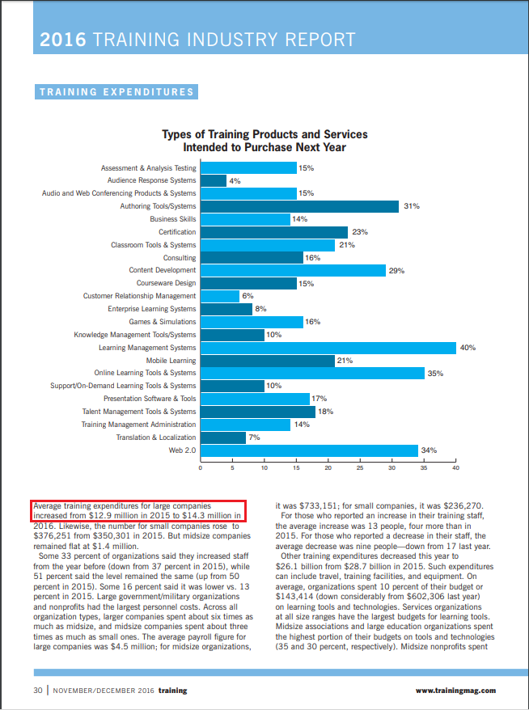
INTRODUCTION
Training spends in the United States alone are growing by 12.4%

Slide 5

Current situation
Traditional Training
Lack of human resources to conduct meeting and courses
Trainers have to train repeatedly
Learners cannot have flexible time to study

Slide 6

Current situation
Send employees outside
Lower employees’ trust
Expensive solution
Can not manage course’s content

Slide 7

Current situation
Buy course online
Can not manage content of course
Can not manage learners’ process

Slide 8

Current situation
Share training program online
Lack of privacy on training courses
User information can be exposed to third party

Slide 9

SOLUTIONS
Provide a system for corporations to train their employees with security and conveniences.
Analyze employees’ studies to make improvements base on results.
Corporations can manage their training plans and users participated in it with ease.

Slide 10

IMPLEMENTATION
1
System overview
2
Features
3
System architecture

Slide 11

Data hierarchy
Brand
Brand
Brand
Plan
Plan
Plan
Program
Program
Course
Course
Course

Slide 12
Course
Section
Section
Section
Lecture
Lecture

Slide 13
Features

Slide 14


SYSTEM ADMIN
System admin
Manage list brands

Slide 15


ADmin
Admin
Manage brand

Slide 16

Manager
Manager
Manage user

Slide 17

Manager
Manager
Manage plans

Slide 18

Manager
Manager
Manage programs

Slide 19

Manager
Manager
Manage skills

Slide 20

Manager
Manager
View report

Slide 21

Manager
Manager
Manage participant

Slide 22

author
Author
Manage course

Slide 23

learner
Lear ner
Enroll course

Slide 24

learner
Lear ner
Learn lecture

Slide 25

learner
Lear ner
Take quiz

Slide 26
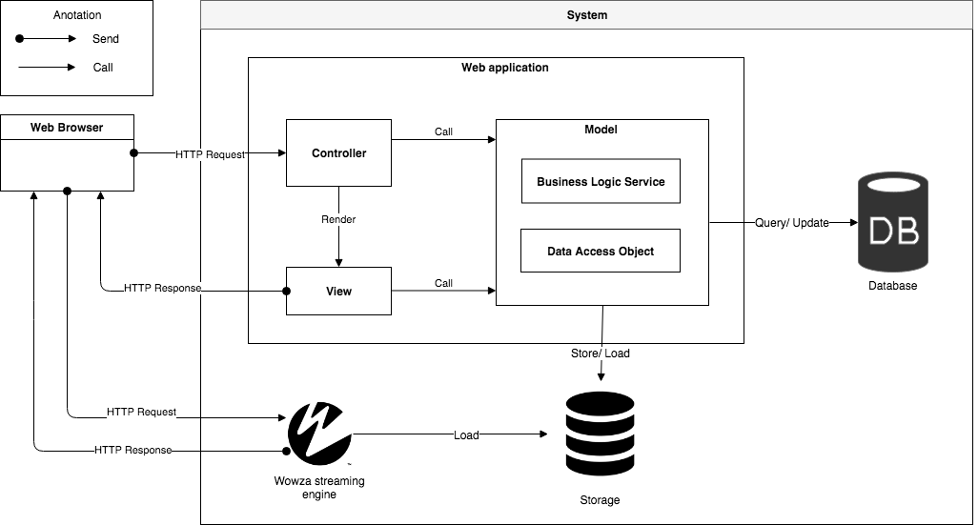
SYSTEM ARCHITECTURE

Slide 27

Algorithm

Slide 28
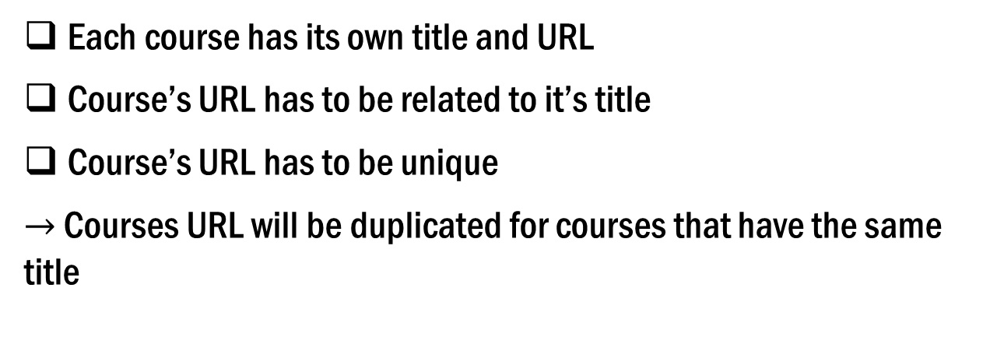
Define problem
Each course has its own title and URL
Course’s URL has to be related to it’s title
Course’s URL has to be unique
$→$ Courses URL will be duplicated for courses that have the same title

Slide 29
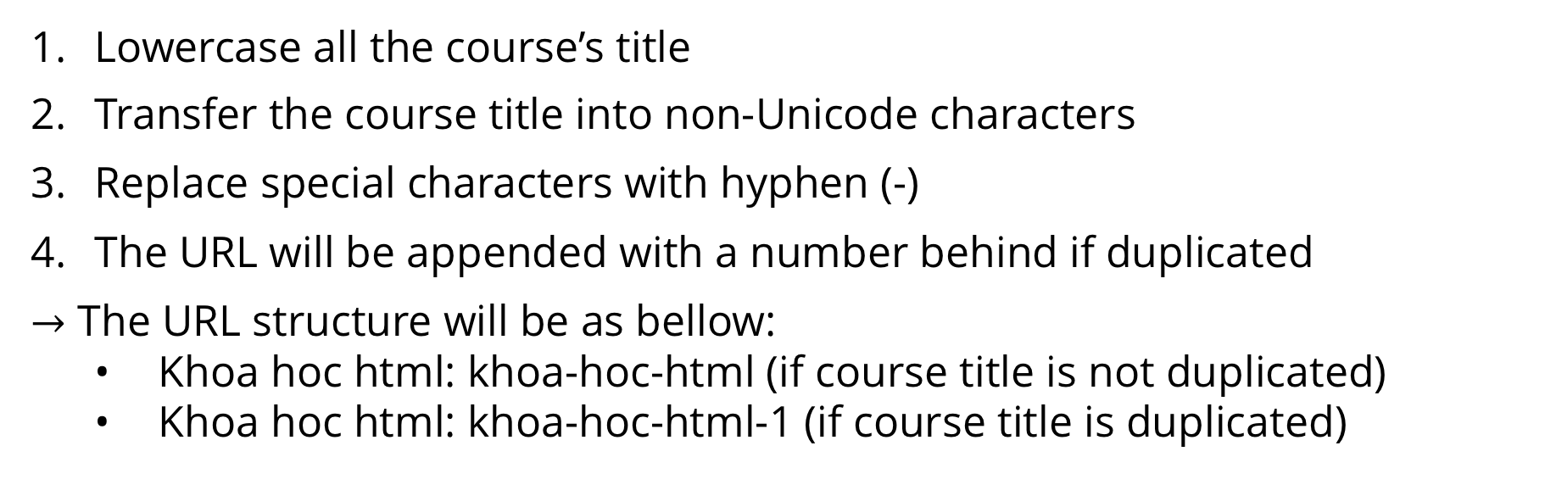
SOlution
Lowercase all the course’s title
Transfer the course title into non-Unicode characters
Replace special characters with hyphen (-)
The URL will be appended with a number behind if duplicated
$→$ The URL structure will be as bellow:
• Khoa hoc html: khoa-hoc-html (if course title is not duplicated)
• Khoa hoc html: khoa-hoc-html-1 (if course title is duplicated)
Flow chart

Slide 30
DEMONSTRATION

Slide 31
DEMO MANAGER: CREATE plan, Create program
Notes:
Thế anh

Slide 32





PROCESS:
1. Open list plans page
2. Click create plan
Manager
Create plan popup
List plans page
3. Input information
4. Update plan infomation
Plan
Plan overview page

Slide 33



5. Add author to plan
6. Add learner to plan
Author
Learner
7. Click create program
8. Update program infomation
8. Fill infomation
Manage program
Create program popup

Slide 34
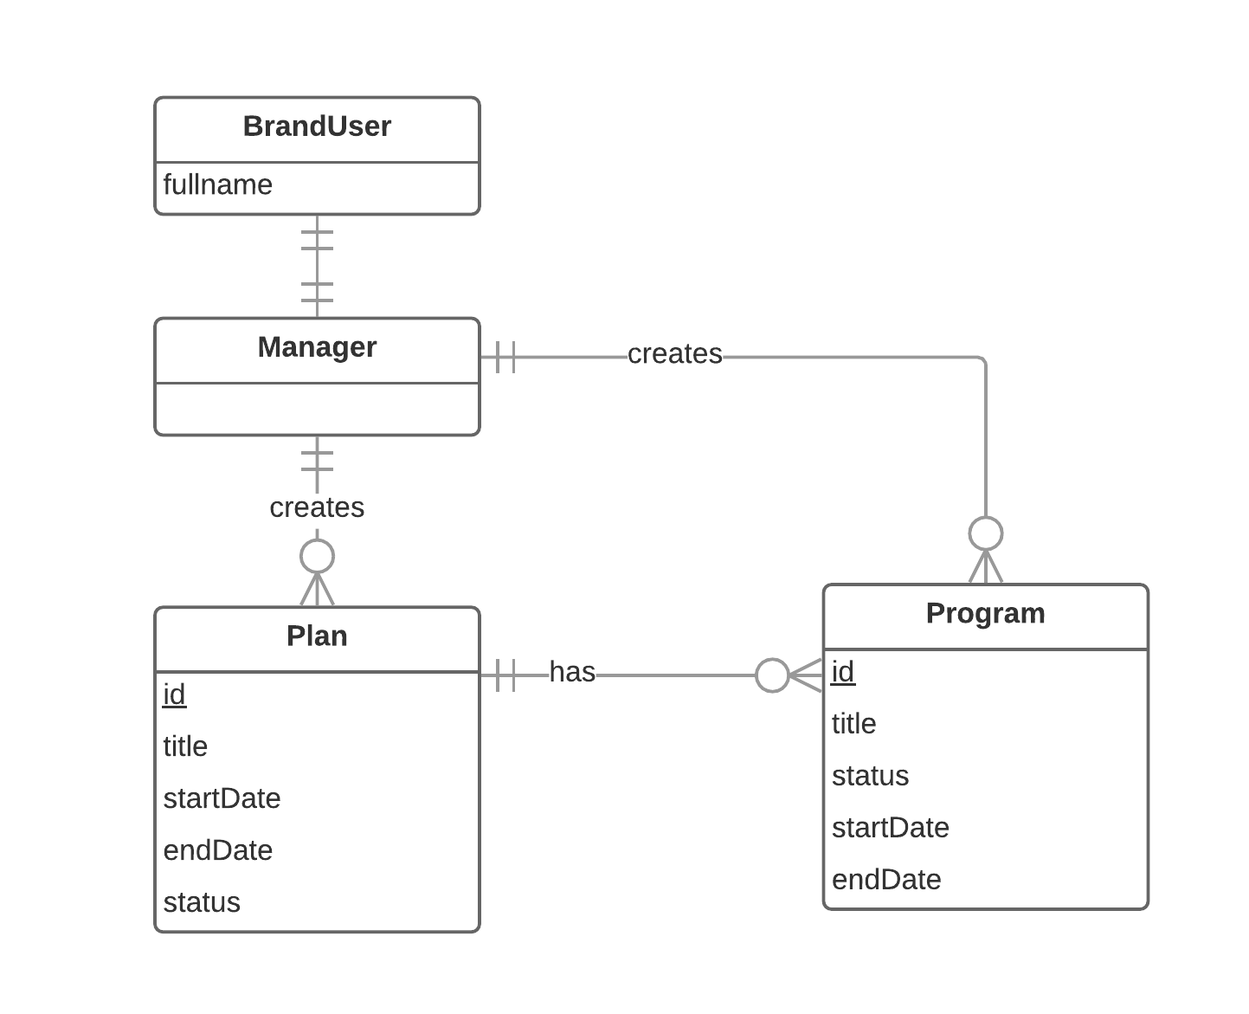
ENTITIES

Slide 35
DEMO author: CREATE Course

Slide 36


PROCESS
1. Open list plan
2. Choose a plan
Author
List plan
Plan overview
3. Choose a program
5. Update course
4. Create a course
Course overview
Program
Notes:
Đầu tiên: tác giả bật traisy web app.
Tiếp theo: tác giả chọn khóa học trong danh sách khóa học của mình, sau đó tác giả bấm thêm bài học cho khóa học đó, , kế tiếp tác giả chỉnh sửa nội dung cho bài học
Cuối cùng: sau khi hoàn tất chỉnh sửa, tác giả lựa chọn “công khai” khóa học

Slide 37


6. Create section
7. Create lecture
Course
Section
Lecture overview
8. Update lecture
9. Send course to review
Lecture

Slide 38
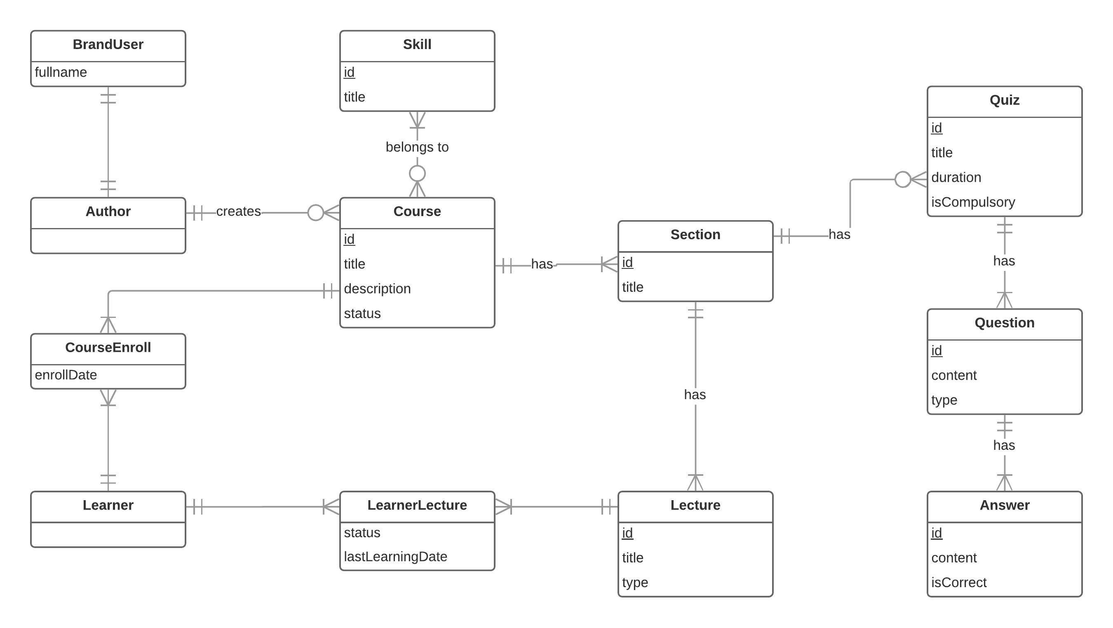
ENTITIes
Notes:
Bỏ coursefeedback

Slide 39
DEMO MANAGER: REView course

Slide 40


PROCESS
1. Open review course page
2. Choose a
specific course
Manager
Review course page
Course overview page
3. Give feedback
4. Approve course
Feedback

Slide 41
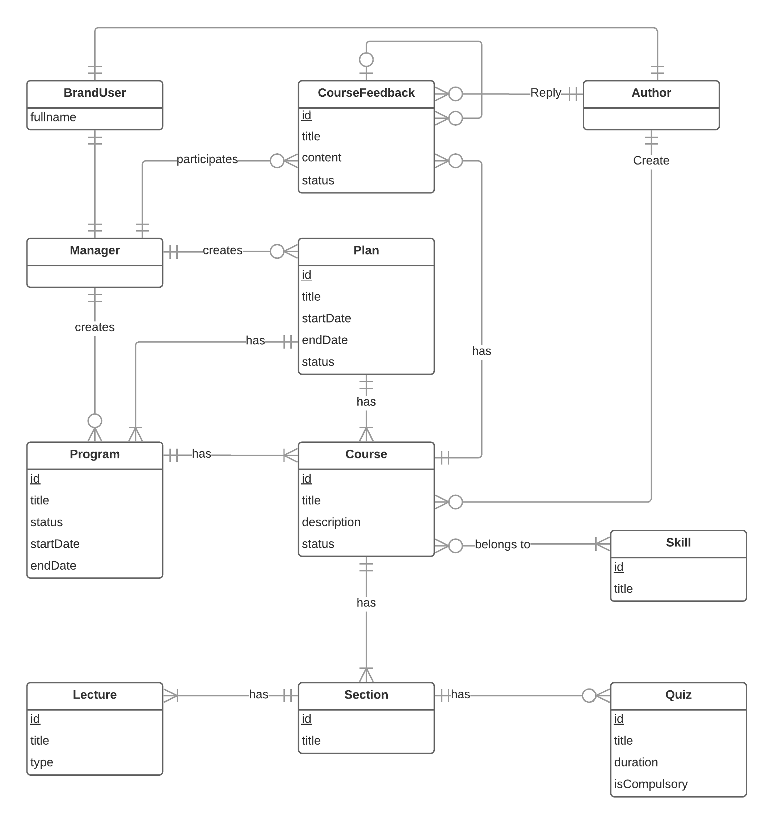
ENTITIES
Notes:
Bỏ lecture/quiz
Thêm author reply feedback
Thêm program

Slide 42
DEMO Learner: Enroll course, learn lecture, take quiz

Slide 43
PROCESS
1. Open list plans page
2. Choose specific plan
Learner
List plans page
Plan overview page
3. Choose a specific program
5. Enroll
4. Choose a
specific course
Course overview page
Programs

Slide 44



5. Learn lecture
6. Take quiz
Learning page
Lecture
Quiz
7. View quiz
result
Result

Slide 45
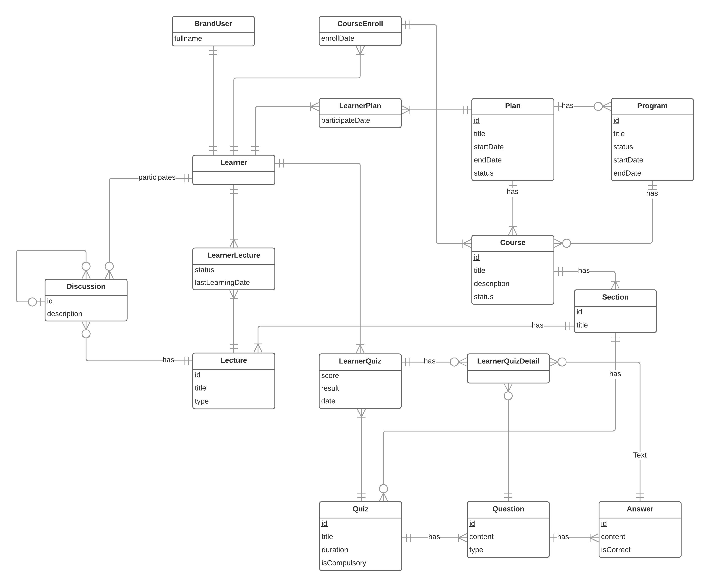
ENTITIES
Notes:
section

Slide 46
DEMO MANAGER: View report -> View report detail

Slide 47



PROCESS
1. Open report page
2. Choose a
specific plan
Manager
Report detail page
Report page
3. Choose a learner/author
Detail information

Slide 48
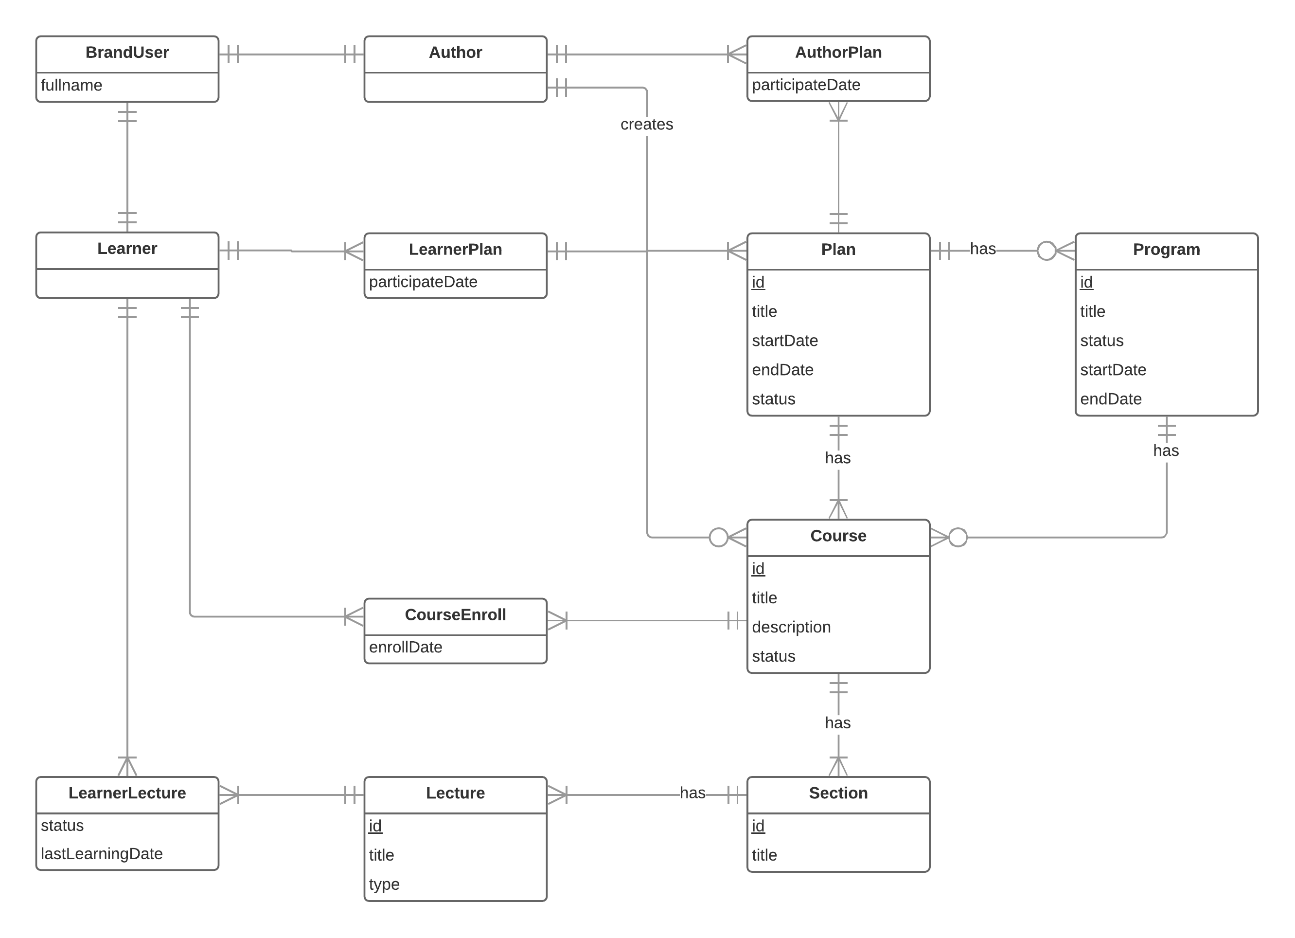
ENTITIES

Slide 49

VALUES
Tightness and clarity. There are different specific training plans, each consisting of programs and courses related to a particular field.
Monitor everything through reports or statistics.

Slide 50

CHALLENGES
Currently only supports the web platform
Limited learning resources

Slide 51

FUTURE PLANS
Develop and improve system on mobile platforms such as iOS, Android, ...
Expanse learning resource

Slide 52
THANK YOU FOR LISTENING

Slide 53


